Slide 1
Gitlab, Git & Issue Tracking
Software Engineering Practice Lab

Slide 2
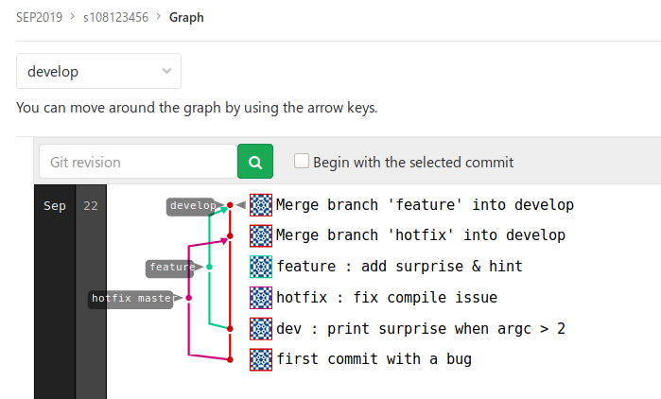
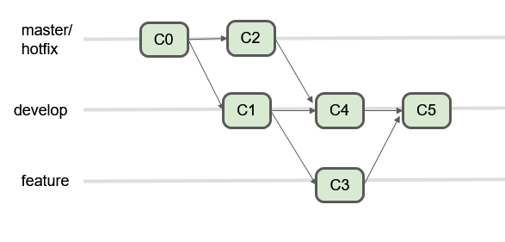
TL;DR Lab Assignment
Create and commit to a repository to make your commit history looks like the figure below. Take a screenshot of your Graph page on GitLab and upload to LMS. Use s+your student ID as name of the repo.
* Learn git for yourself. This is not only a assignment. Modifying webpage/image to fake a screenshot is not suggested.

Slide 3
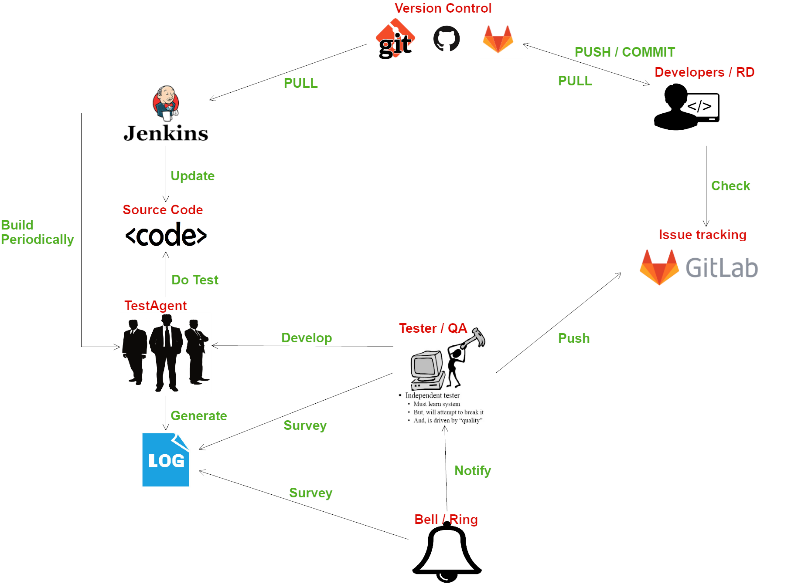

Slide 4
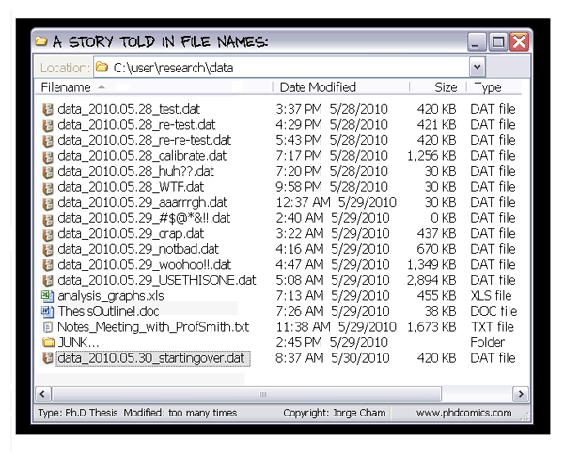
Why do we need a Version Control System?

Slide 5
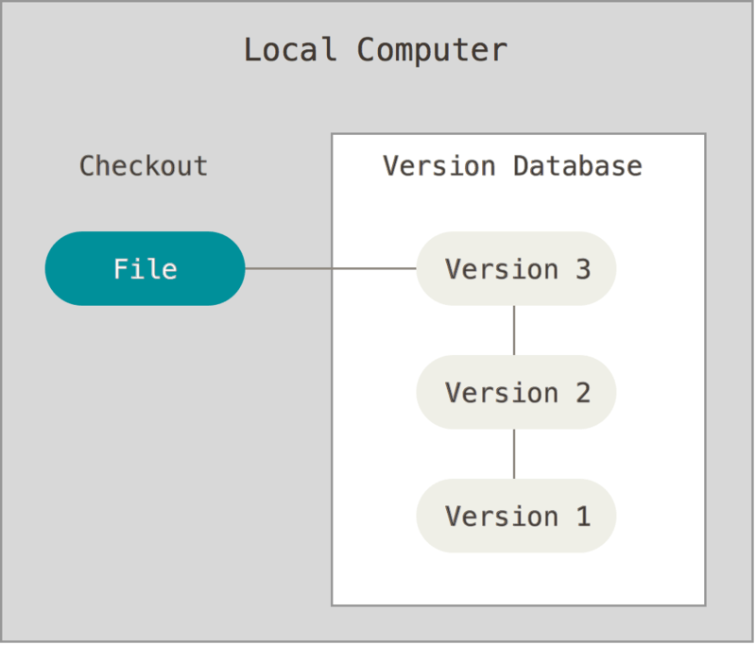
What’s a Version Control System?
A version control system(VCS) tracks the history of changes as people and teams collaborate on projects together. As the project evolves, teams can run tests, fix bugs, and contribute new code with the confidence that any version can be recovered at any time.
Developers can review project history to find out:
Which changes were made?
Who made the changes?
When were the changes made?
Why were changes needed?
https://guides.github.com/introduction/git-handbook/

Slide 6
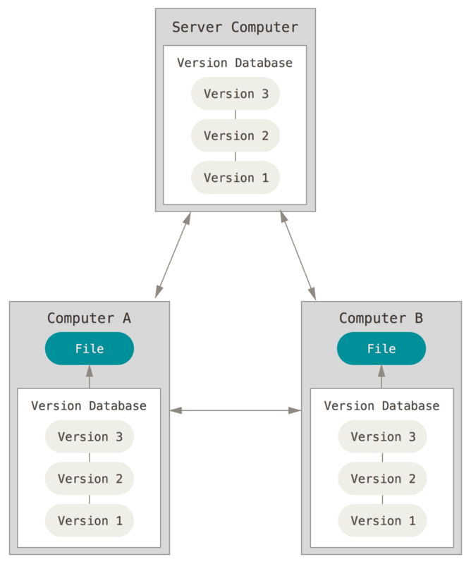



What is Git/GitHub/GitLab/BitBucket?
Git is a Distributed Version Control System(DVCS)
Clients fully mirror the Version Database(repository), including its full history
DVCS do not need a constant connection to the server.
GitHub/BitBucket/GitLab are Git hosting providers that can store you repository online and provide further collaborate features like Issue tracking, Project Management, Pull requests, and Code Review.
Client can push changes to the server, pull changes from the server, or clone from the server if repo is not exist locally.

Slide 7

Repository/Commit/Branches
A repository, or Git project, encompasses the entire collection of files and folders associated with a project, along with each file’s revision history.
The file history appears as snapshots in time called commits(the dots), and the commits exist as a linked-list relationship, and can be organized into multiple lines of development called branches(the lines).

Slide 8
Git Workflow Practice

Slide 9






One git to rule them all All GUIs work with same ‘git’ idea
git commandline | GitHub Desktop | GitKraken | SmartGit | SourceTree | TortoiseGit
All Platform | Win/macOS/ Linux(unofficial) | Win/macOS/ Linux | Win/macOS/ Linux | Win/macOS | Windows Only
available everywhere and most stable | Easy to start, open source and well integration with GitHub | Equipped with powerful diff and tracing tools free for non-commercial | Many advanced feature of git provided in GUI free for non-commercial | Famous in the old days and (maybe) well integration with Bitbucket | Open source and deeply integration with Windows...
git-scm.com | desktop.github.com (^ Windows/macOS) Unofficial Linux Builds | www.gitkraken.com/ git-client | www.syntevo.com/ smartgit | www.sourcetreeapp.com
Git is even available from VSCode/Visual Studio/IntelliJ/Eclipse...etc!

Slide 10
Software Installation
Git by command line Windows/macOS(Installer): https://git-scm.com/download/ （Download Portable version in the PC room) Windows(Chocolatey): choco install git macOS(Homebrew): brew install git Ubuntu: (sudo) apt install git
GitHub Desktop with fancy GUI Windows/macOS(Installer): https://desktop.github.com/ Windows(Chocolatey): choco install github-desktop macOS(Homebrew): brew cask install github Ubuntu: https://github.com/shiftkey/desktop/releases # Install from snap may have some problems as for 2.1.0-linux1
* You can also get installers from NCU-LMS://Shared Documents/Software Resources.

Slide 11
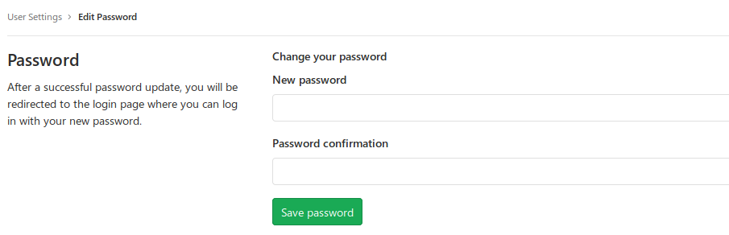
Create a Gitlab Account
We will use Gitlab to host the repository in this lab
Register a new account https://gitlab.com/users/sign_in#register-pane * You may also login with Google account, but will need to set password after first login; Go to https://gitlab.com/profile/password/edit and set your password. This password may be remembered by git credential, so do not use this password on other sites.

Slide 12
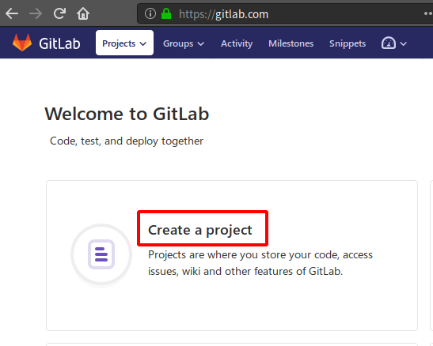
Create a new repository on the server
Remote Server
Local

Slide 13
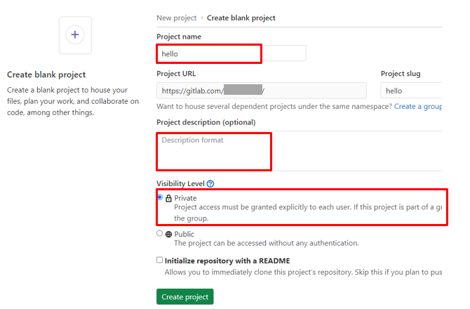
Create a new repository on the server cont’d
Remote Server
New Repository
Local

Slide 14
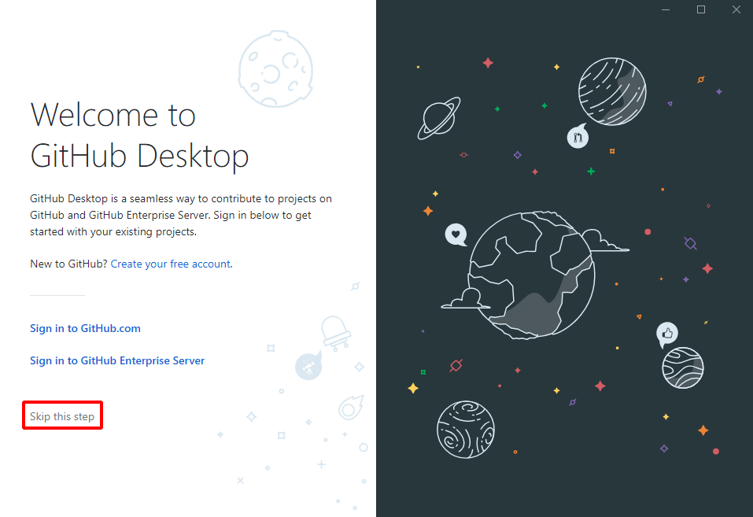
Setup Local Software GitHub Desktop - 1
Remote Server
New Repository
Local

Slide 15
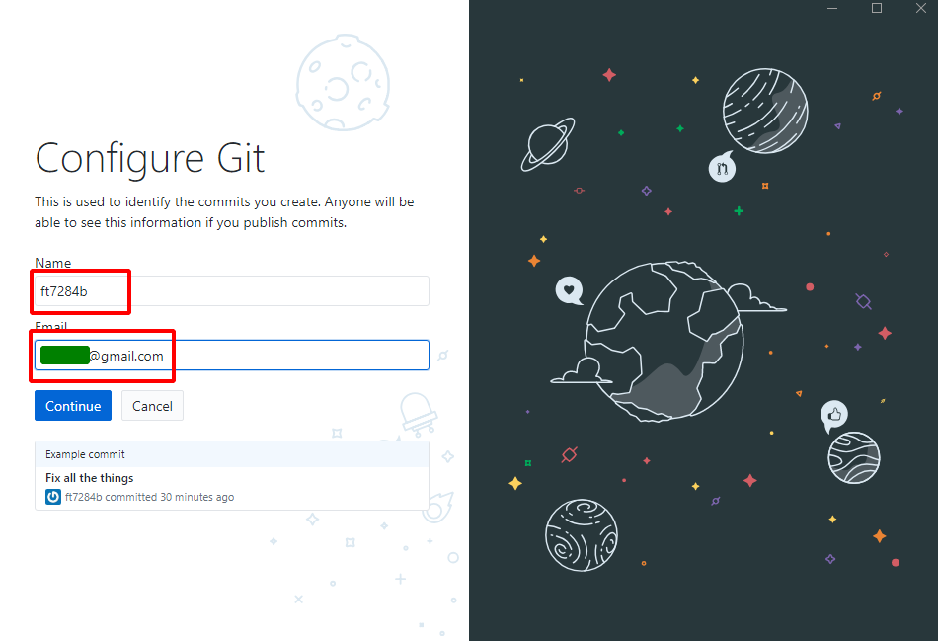
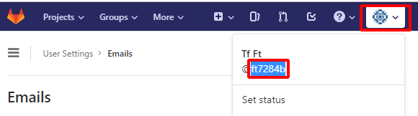
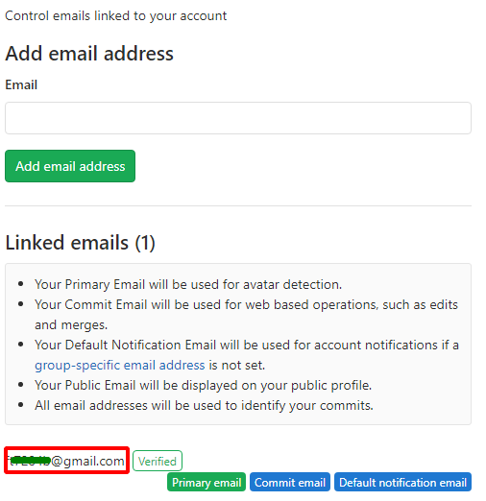
Setup Local Software GitHub Desktop - 2
Remote Server
New Repository
Local

Slide 16
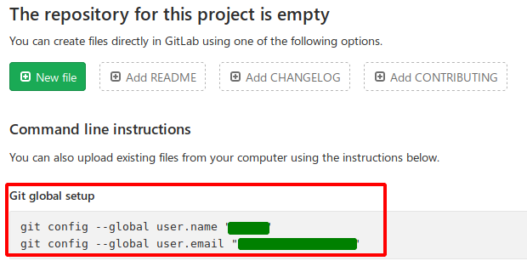
Setup Local Software Git Command
https://git-scm.com/book/en/v2/Getting-Started-First-Time-Git-Setup
$ git config --global user.name "YOUR_USER_NAME" $ git config --global user.email "YOUR_EMAIL"
Remote Server
New Repository
Local

Slide 17
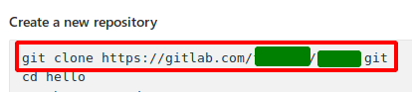
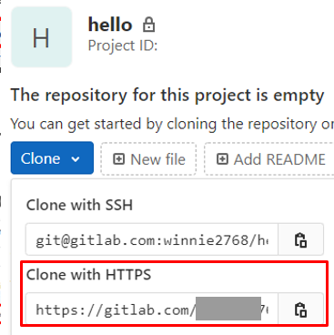
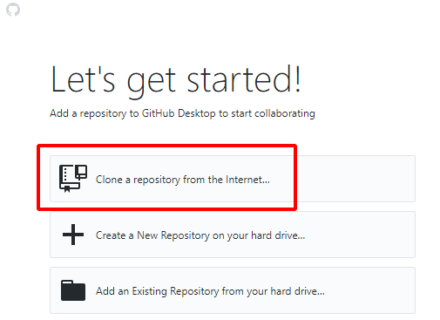
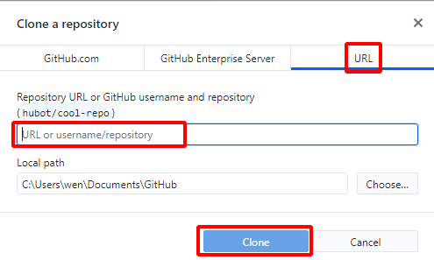
Clone Repo from Server to Local
# via Git Command :
v via Github Desktop : 1. Copy the .git URL from webpage 2. “Clone” the new repo, paste this URL on the GUI
Remote Server
New Repository
Local
New Repository

Slide 18
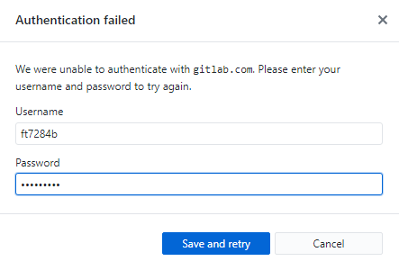
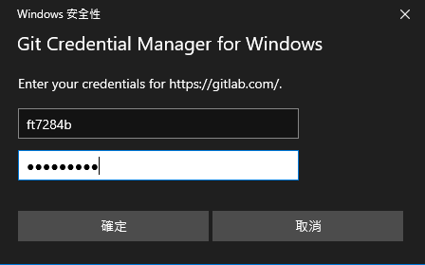
Clone Repo from Server to Local GitHub Desktop - 2
Enter password you created at register or Settings>Password, then click ‘Save and retry’.
Remote Server
New Repository
# via Git Command :
Local
New Repository

Slide 19
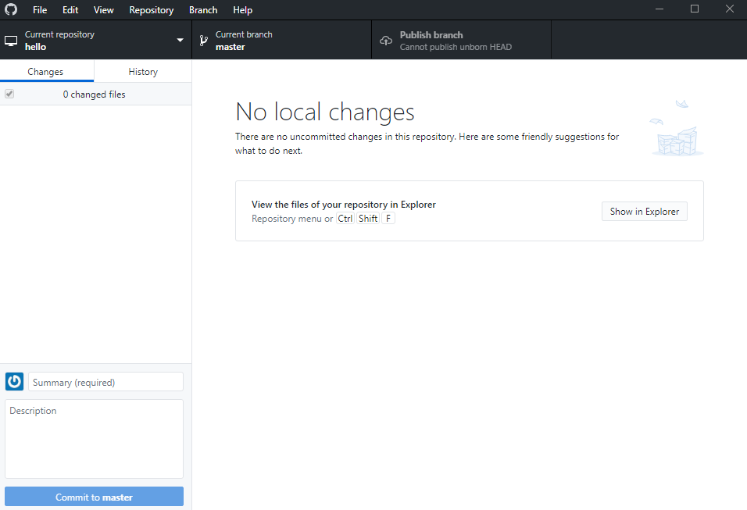
Clone Finished
Remote Server
New Repository
$ cd repo_name $ git status On branch master No commits yet nothing to commit (create/copy files and use “git add” to track)
Local
New Repository

Slide 20
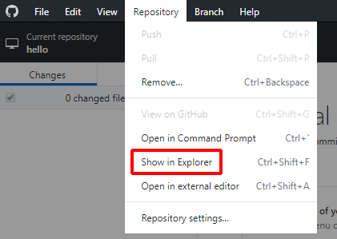
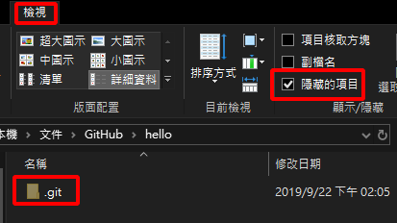
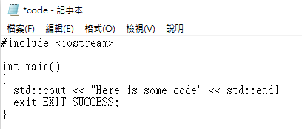

Prepare your first commit
Create a text file named code.txt in the repo folder , enter following content (with a bug?) then save :
Remote Server
Repository
Turn on “show hidden files” in Windows Explorer(or your file browser) to see the .git folder
Local
Repository
Unstaged Changes

Slide 21
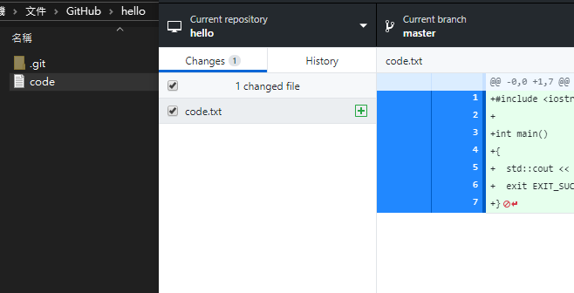
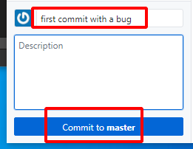
Commit
$ git status … Untracked files: (use “git add <file>...” to include in what will be commited) code.txt nothing added to commit …
$ git add . $ git status … new file: code.txt ... $ git commit -m “first commit with a bug”
Remote Server
Repository
Local
Repository
Version 1
https://git-scm.com/book/en/v2/Git-Basics-Recording-Changes-to-the-Repository

Slide 22
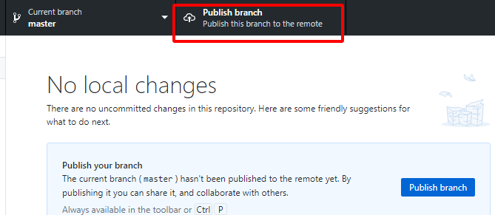
Push to Remote Server
$ git push origin … Enumerating objects: 3, done. … * [ new branch ] master -> master
Remote Server(origin)
Repository
Local
Repository
Version 1

Slide 23
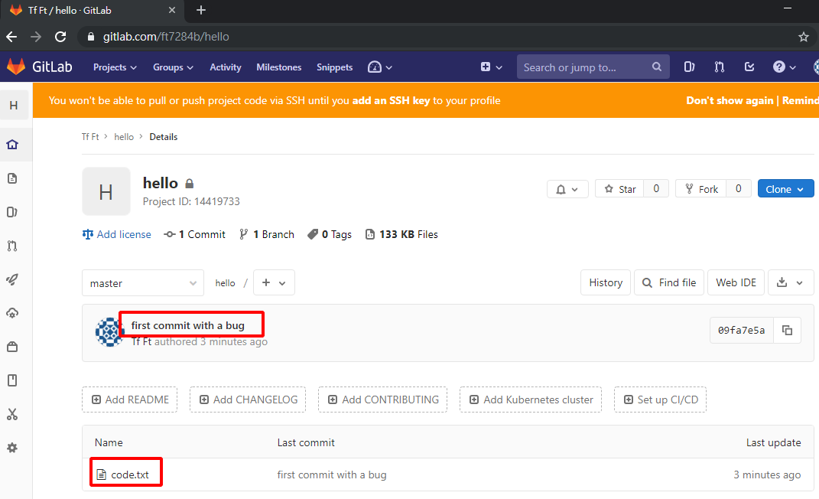
Push completed
Remote Server(origin)
Repository
Version 1
Local
Repository
Version 1

Slide 24
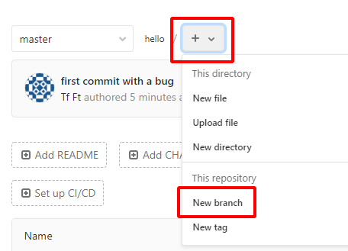
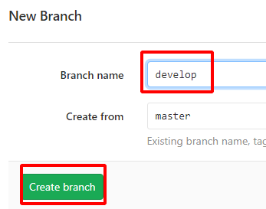
Create a branch Develop safe without affecting stable version
Remote Server(origin)
Repository
master
develop
Version 1
Version 1
Local
Repository
Version 1

Slide 25
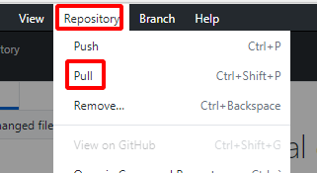
Pull changes from the server
$ git pull From … * [ new branch ] develop -> origin/develop Already up to date.
Remote Server(origin)
Repository
master
develop
Version 1
Version 1
Local
Repository
Version 1
Why Fetch will also work in this case? https://git-scm.com/book/en/v2/Git-Branching-Remote-Branches #Pulling

Slide 26
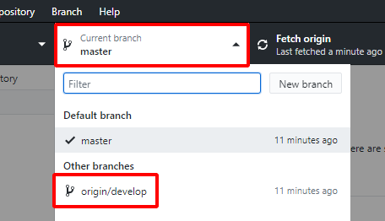

Checkout to another branch
$ git checkout develop Switched to branch ‘develop’ Your branch is up to date with ‘origin/develop’.
Remote Server(origin)
Repository
master
develop
Version 1
Version 1
Local
Repository
master
develop
Version 1
Version 1
HEAD

Slide 27
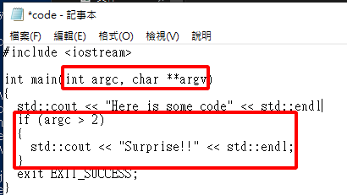
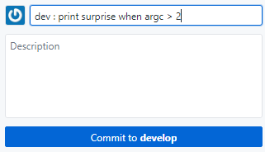
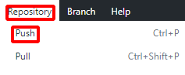
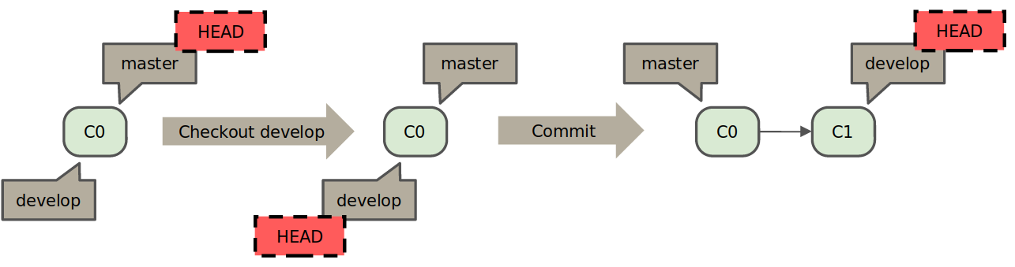
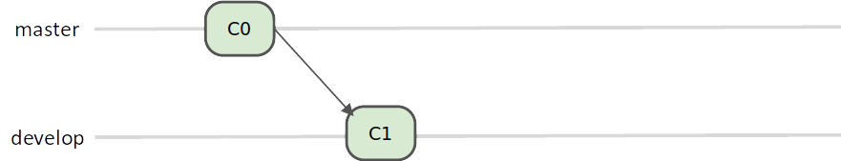
After checkout, commit & push development code
Remote Server(origin)
Repository
master
develop
Version 1
Version 1
Local
Repository
master
develop
Version 1
Version 1
Version 2
HEAD

Slide 28
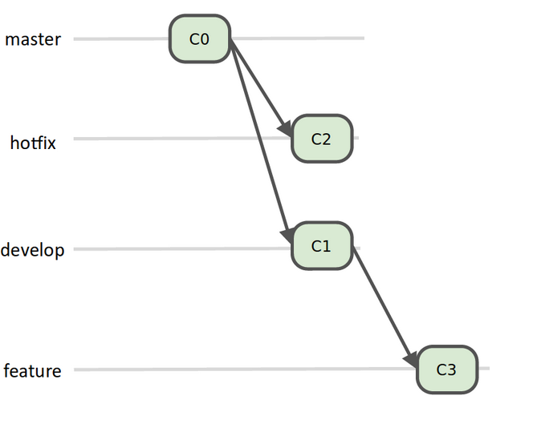
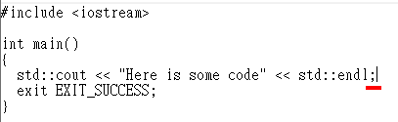
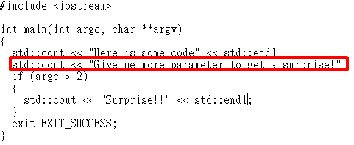
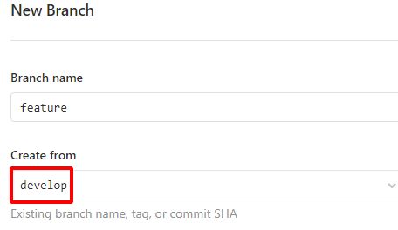
Create required branch, and make commits
Code content

Slide 29
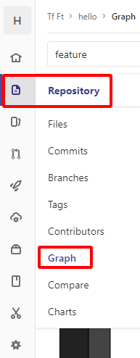

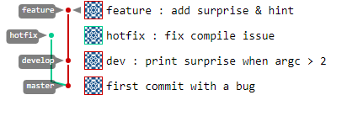

The git graph will looks like this :
# Q : I have done something wrong! # Can I ‘undo’ last commit ? $ git reset HEAD^ --soft # SmartGit has this feature in GUI, but # Github Desktop seems not. https://git-scm.com/book/zh-tw/v2/Git-Tools-Reset-Demystified
C3
C2
C1
C0

Slide 30
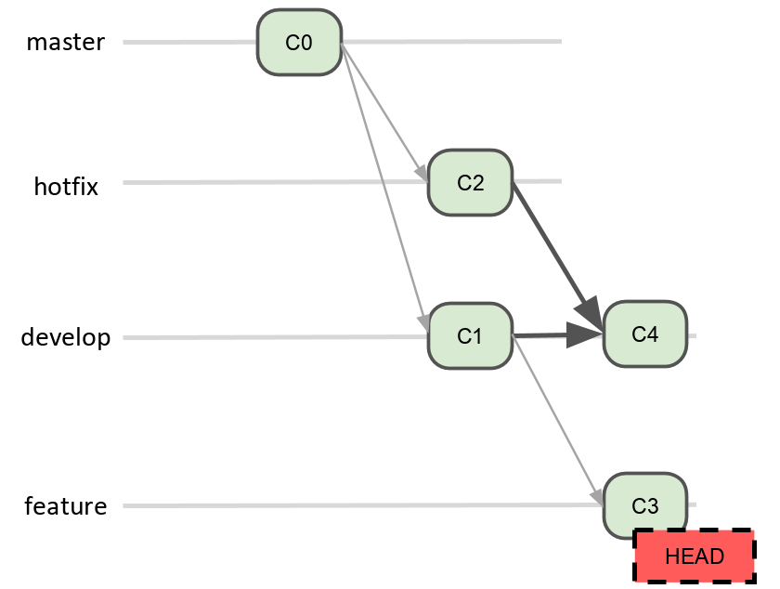
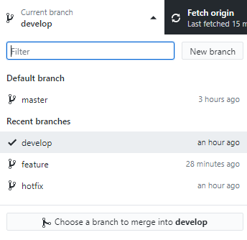
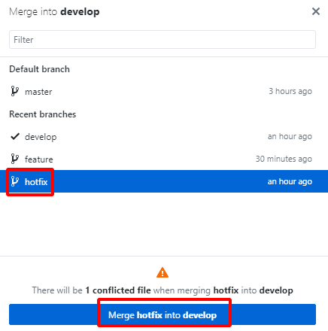
Conflict Merge
$ git checkout develop $ git merge hotfix Auto-merging code.txt CONFLICT (content): Merge conflict in code.txt Automatic merge failed; fix conflicts and then commit the result.

Slide 31
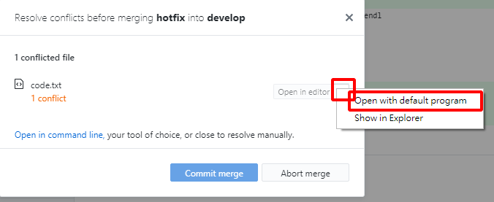
Conflict Merge Get into the problem
Openthe file with conflicts by yourself using vim, nano or your preferred editor.

Slide 32
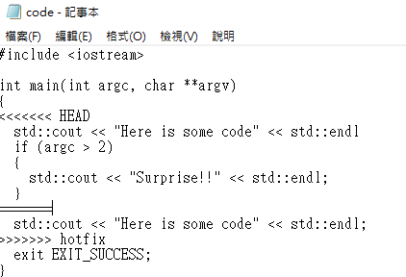

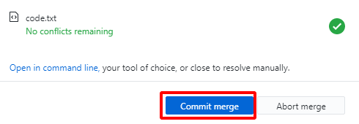
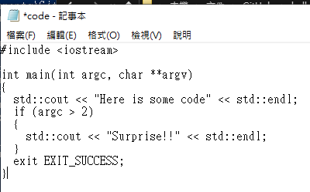
Conflict Merge So, what do you want to make the code work?
// This does not looks good.
// The code will actually works. // Keep this one.
Modify the file to make it look like this and save.
Then make a commit and push. This is a ‘merge commit’.
https://help.github.com/en/articles/resolving-a-merge-conflict-using-the-command-line

Slide 33



After Merge
C4
C3
C2
C1
C0

Slide 34


Fast-forward
Some merges do not conflict and is called fast-forward. No commits will be done, git will just move the HEAD.
$ git checkout master $ git merge hotfix Updating XXXXXXX..XXXXXXX Fast-forward code.txt | 2 +- 1 file changed, 1 insertion(+), 1 deletion(-)

Slide 35
Practice

Slide 36
Learn more about git
Learn Git Branching https://learngitbranching.js.org/
Draw Taipei MRT Road Map by git - COSCUP 2016 用 git 線圖畫台北捷運路網 https://youtu.be/TR6emfqfkWk https://blog.othree.net/log/2016/09/17/git-mrt/
Pro Git Book 2nd Edition(2014), CC BY-NC-SA 3.0 https://git-scm.com/book/en/v2

Slide 37

Issue Tracking The Largest-scale live chat room in the World ?
https://github.com/denoland/deno/issues/25

Slide 38




Issue Tracking Tracking Issues from live chat to your ‘life’
https://github.com/ant-design/ant-design/issues/13819

Slide 39


Issue Tracking
https://github.com/ant-design/ant-design/issues/13098

Slide 40
Issue Tracking features provided by GitLab
List
Boards
Kanban https://en.wikipedia.org/wiki/Kanban_(development)
Labels
Milestones
You can get overview of these tools and details in https://docs.gitlab.com/ee/user/project/issues/ .

Slide 41
Guidelines for creating issues
Issue tracking guidelines can be found in many project’s CONTRIBUTING file:
Microsoft Visual Studio Code Before you create a new issue, please do a search in open issues … Do not add your issue as a comment to an existing issue unless it's for the identical input. Many issues look similar, but have different causes. The more information you can provide, the more likely someone will be successful at reproducing the issue and finding a fix... https://github.com/microsoft/vscode/blob/master/CONTRIBUTING.md
Google Android A bug that simply says something isn't working doesn't help much, ... https://source.android.com/setup/contribute/report-bugs.html
At least share following information in your issue:
Your enviromental settings (OS, software, …)
Reproducible steps (1... 2... 3...) that cause the issue
What you expected to see, versus what you actually saw
Program Outputs/Logs/Errors

